Slide 1

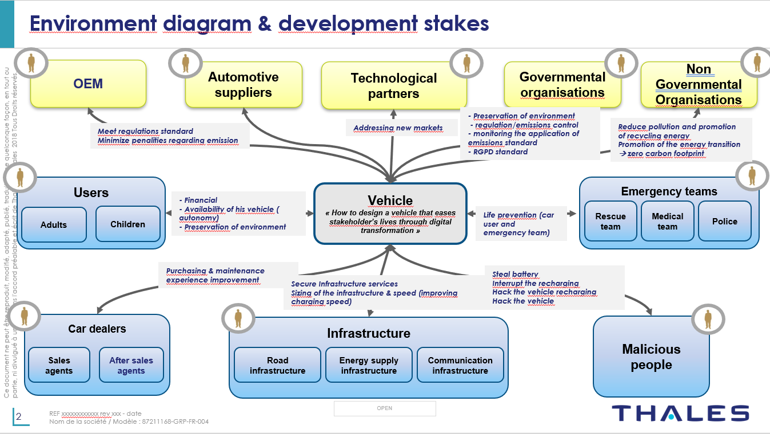
Poster title, Authors,Logo (school and City)
Problematics : Seize the opportunity
Key stakes with
key Kpis and figures
Objectives
Concerns
Strategy and key Assumptions
Solution
Present strategies identified to solve the issue, desicribe key assumption and key decisions
Describe your solutions to solve problem identified (illustrate with relevant diagram and picture)
Describe your solutions to solve problem identified (illustrate with relevant diagram and picture)
Conclusion
Explain how proposed solution resolves the issues raised in the introduction (show KPI improvement, etc.)

